Slide 1
Effect of bioadaptive impulse therapy on pain and the autonomic nervous system during physiotherapeutic treatment using the MedKey
Univ.-Prof. Dr. Kuno Hottenrott
Martin-Luther-University Halle-Wittenberg

Slide 2
Scientific background
HRV is a biomarker for specific pain-related diseases (Lerma et al., 2011) and a outcome measure for the relief of pain due to therapeutic interventions (Storella et al., 1999; Zhang et al.,2006; Toro-Velasco et al., 2009).
Patients with chronic pain show a reduction in HRV and baroreflex sensibility due to changes in efferent sympathetic and parasympathetic cardiac activity, which shift the balance to a sympathetic tone prevalence related to catecholamine release [Nielsen et al., 2014; Broehl et al., 2005].
Higher parasympathetic activity was associated with better self-regulation capacities and, accordingly, a higher pain inhibition capacity (Forte et al., 2022).
https://www.ncbi.nlm.nih.gov/pmc/articles/PMC8870705/

Slide 3
Aim of the study
Aim of the study is to examine the extent to which treatments with adaptively regulated impulse therapy have an influence on the cardiovascular system, autonomic nervous system, cardiac autonomic regulation and existing pain during physiotherapy treatments.

Slide 4
Method
The basis of the examination is the continuous measurement of the heart rate (RR interval) and the determination of heart rate variability. The data was collected while lying down using a special, ECG-accurate chest strap and a specially designed app (HRV-Elite) before, during and after treatment.
Patients (m/f/d) with the appropriate indication were selected for this. The treatments took place twice a week for a period of 3 weeks - a total of 6 treatments.

Slide 5
Method
A continuous treatment protocol was used for 8 patient over the treatment period. The following data was collected in addition to the RR measurement:
VAS pain level 1-10 pre-post per application at rest and during joint movement Dysfunction level 1-10 pre-post per application
Gender
Age
Weight
Duration of complaint since onset of complaint
Complaint location
Duration of treatment per application
Medication taken

Slide 6
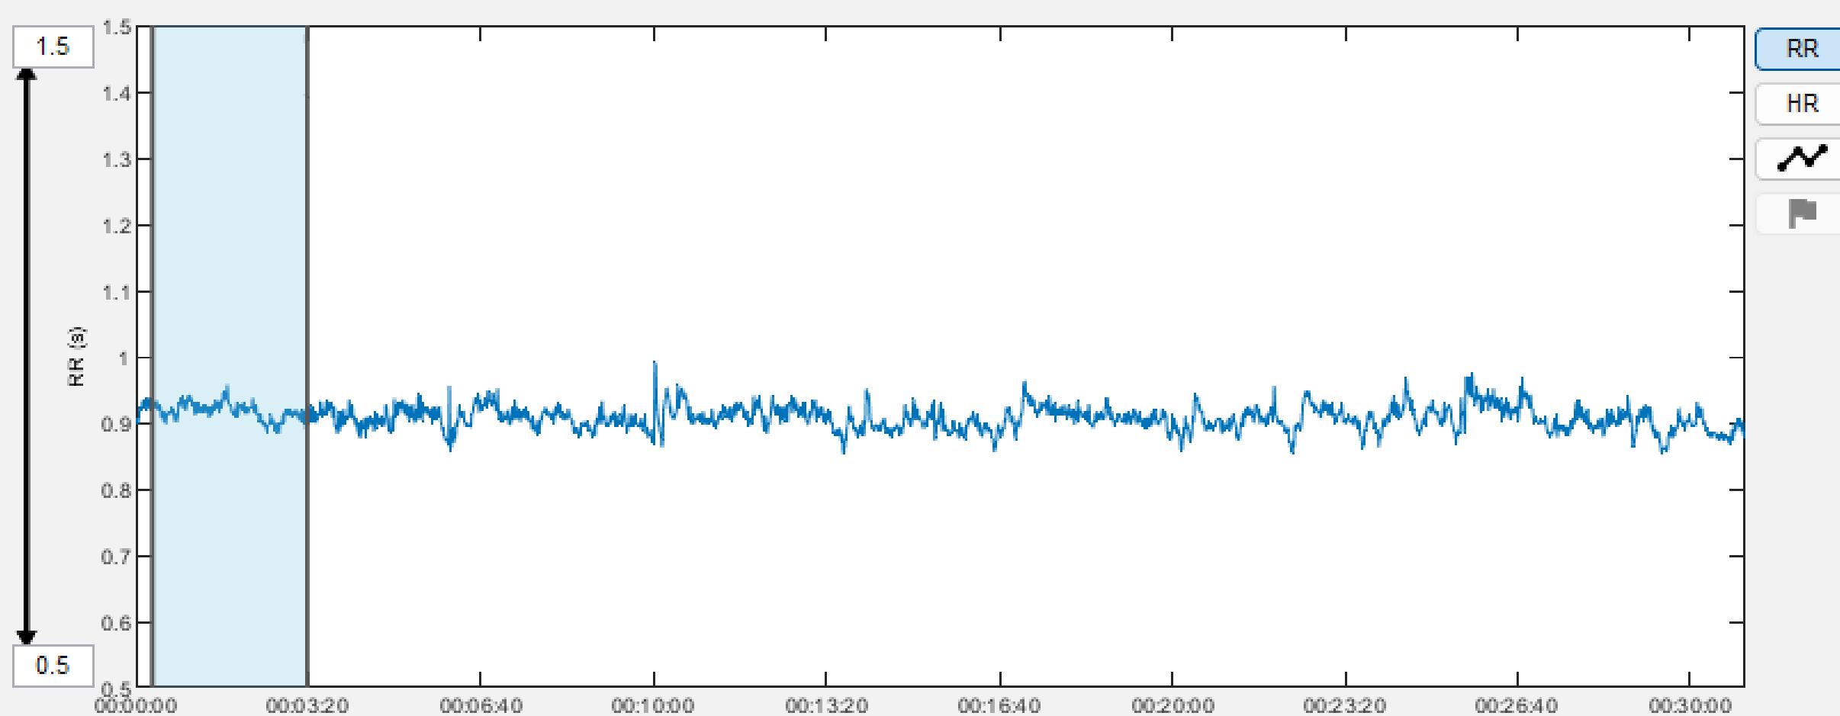


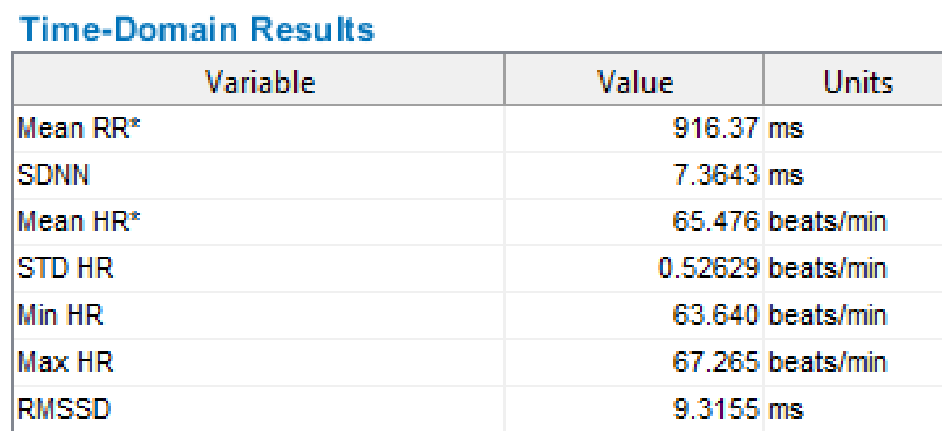
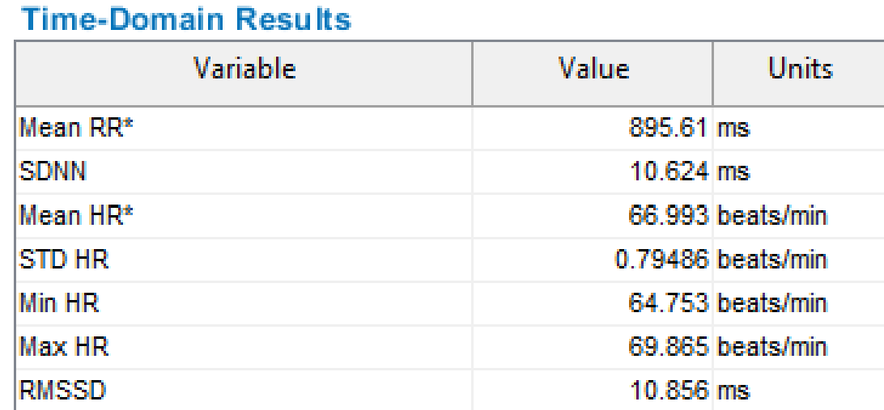
Data Analysis
20 min Treamtent with Medkey
3 min
3 min

Slide 7
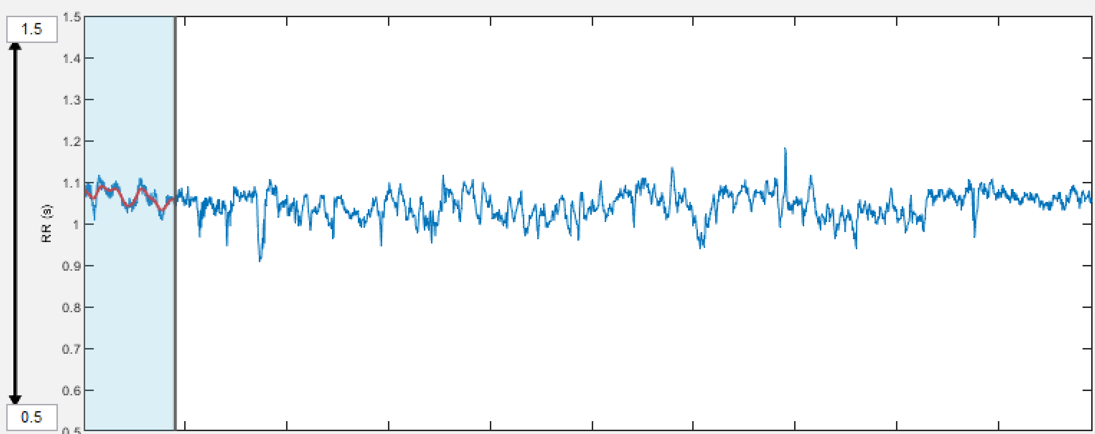
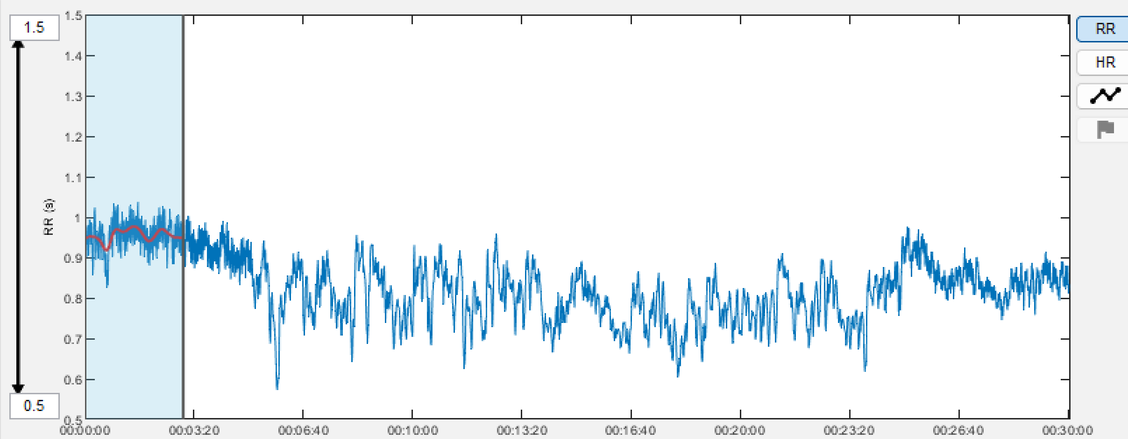
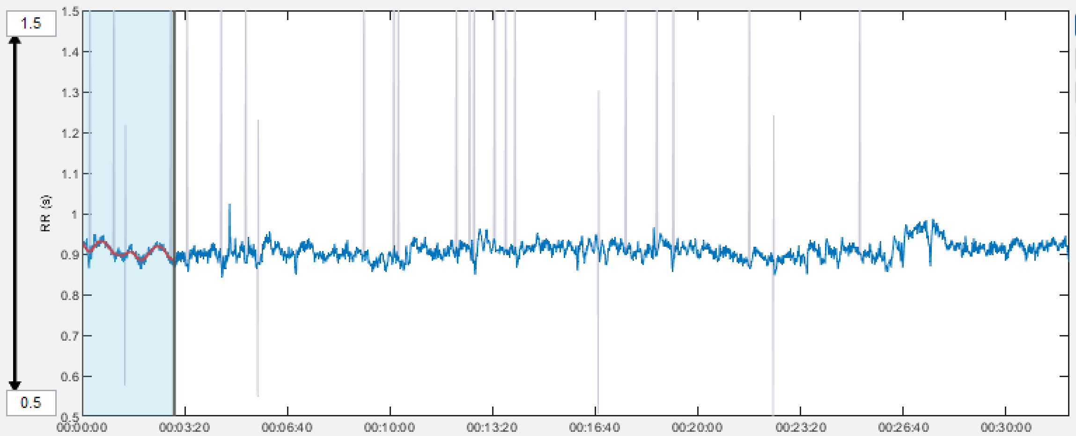
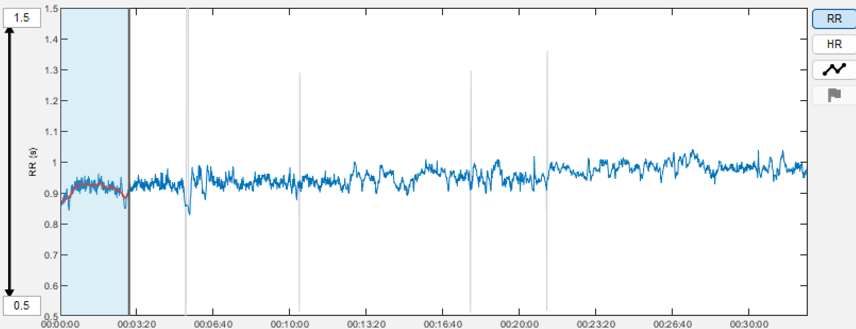
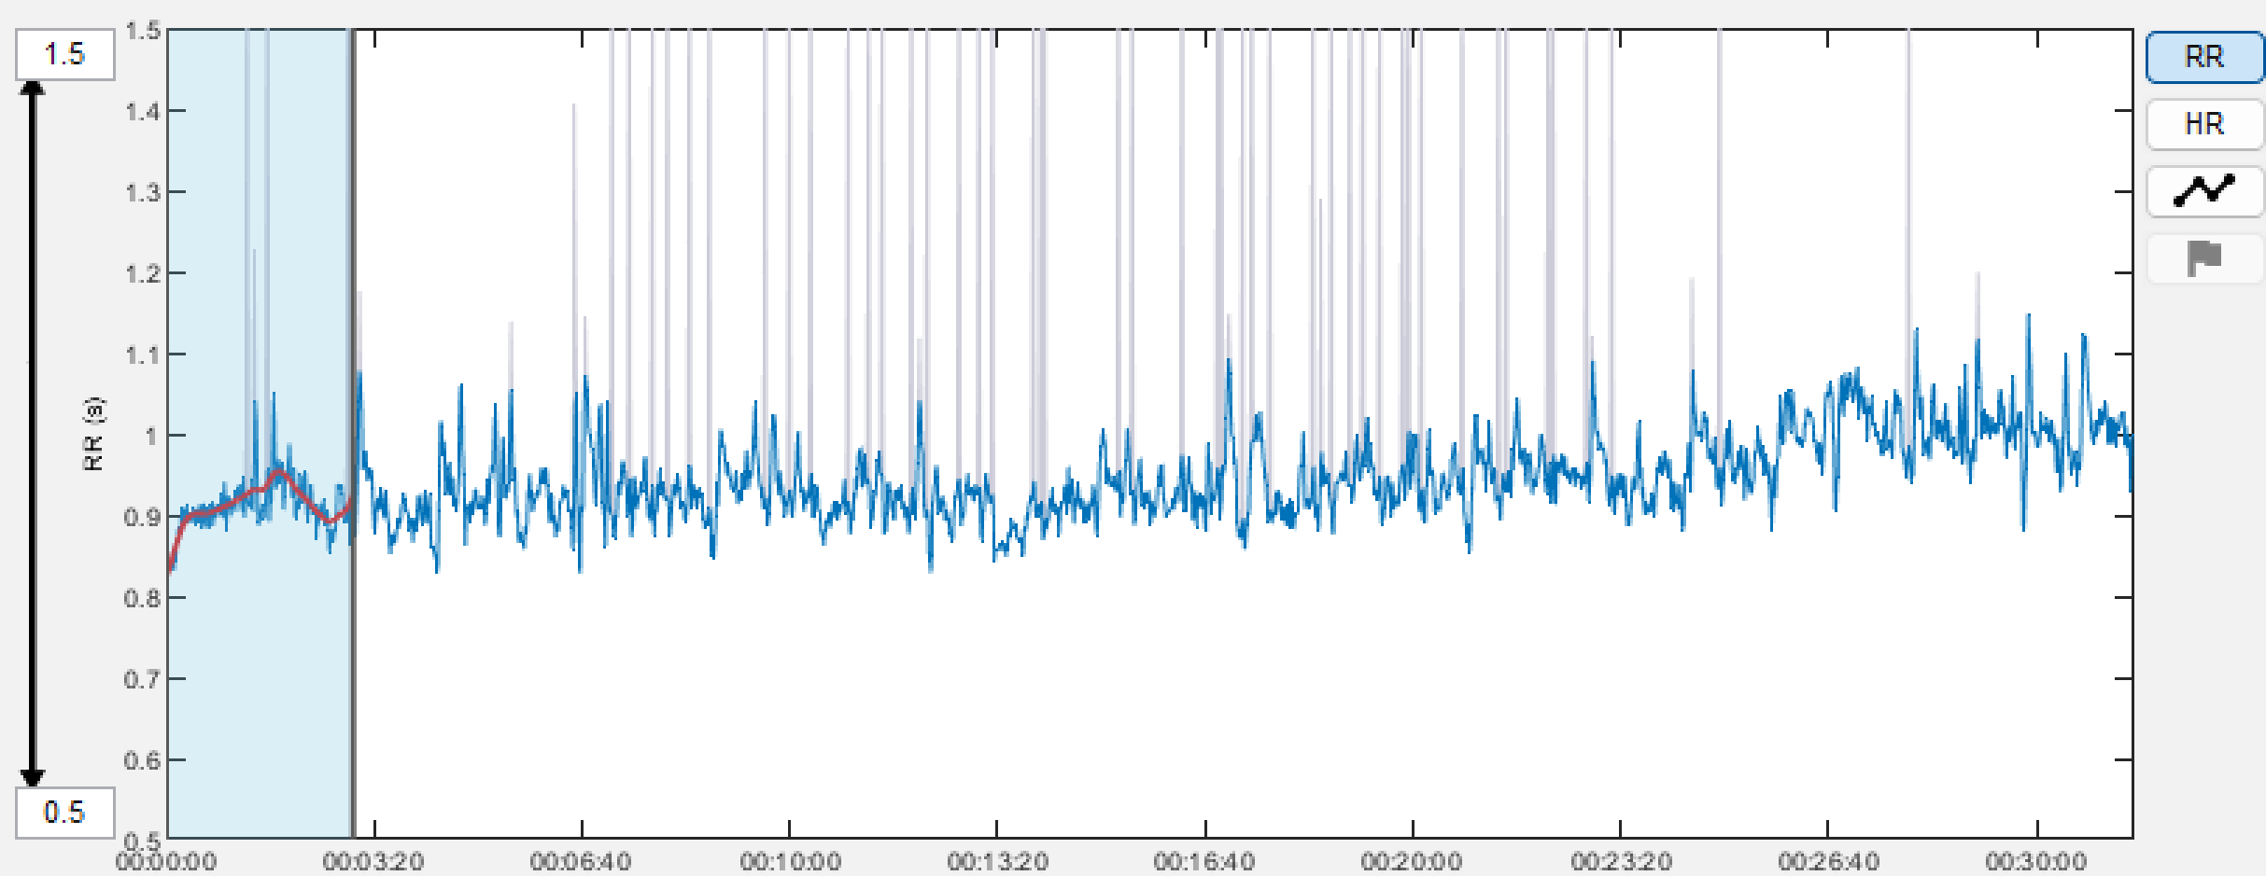
Standardized MedKey – Sessions
Subject 6
Treatment 1
Treatment 4
Treatment 2
Treatment 5
Treatment 3
Treatment 6

Slide 8
Heart Rate in Supine Position
N = 8
Measurement 3 min in supine position

Slide 9
Significant Increase Vagal Activity
N = 8
*
p < 0,05
Measurement 3 min in supine position

Slide 10
Signifcant Decrease Stress Level
*
N = 8
p < 0,05
Measurement 3 min in supine position before treatment

Slide 11
Effect of the Medkey Sessions on pain and stress
All treatments in which the patients stated that they were in pain before the treatment
were evaluated.
Results:
1. For all treatments, the 20 min Medkey Session achieved a reduction in pain
for all test subjects by an average of 3 points on the VAS-Skala (0-10).
2. Stress level decrease sig. from 14,8 to 13,2 (p < 0,05)

